Slide 1
Data Mining Assignment 2
Team Data Miners
Emma Focht, Nhi Tran, Nicole Ihlenfield, Dylan Curran, Nicholas Kemper

Slide 2
Predicting IMDB Score: Predictors
Numerical variables
movie_facebook_likes
num_voted_users
num_critic_for_reviews
num_user_for_reviews
duration
director_facebook_likes
actor_3_facebook_likes
actor_1_facebook_likes
gross
cast_total_facebook_likes
facenumber_in_poster
budget
Actor_2_facebook_likes
Aspect_ratio
Categorical variables (converted into dummy variables)
Content_rating
Genres
Title_year

Slide 3
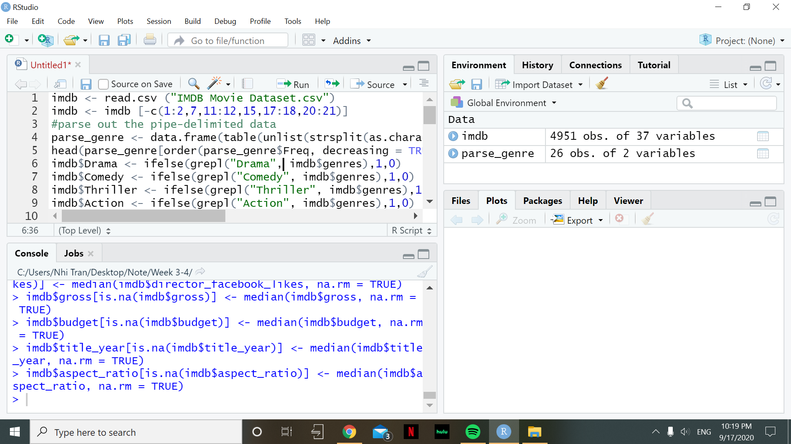
Pre-Processing Data
Dropping irrelevant variables
Some irrelevant predictors that should be dropped:
Color (most of the records in the dataset are color)
Directors and actors’ names
Keyword
IMDB link
Language and country
Notes:
imdb <- read.csv ("IMDB Movie Dataset.csv")
imdb <- imdb [-c(1:2,7,11:12,15,17:18,20:21)]
#parse out the pipe-delimited data
parse_genre <- data.frame(table(unlist(strsplit(as.character(imdb$genres), split = "|", fixed = TRUE))))
head(parse_genre[order(parse_genre$Freq, decreasing = TRUE),],20)
imdb$Drama <- ifelse(grepl("Drama", imdb$genres),1,0)
imdb$Comedy <- ifelse(grepl("Comedy", imdb$genres),1,0)
imdb$Thriller <- ifelse(grepl("Thriller", imdb$genres),1,0)
imdb$Action <- ifelse(grepl("Action", imdb$genres),1,0)
imdb$Romance <- ifelse(grepl("Romance", imdb$genres),1,0)
imdb$Adventure <- ifelse(grepl("Adventure", imdb$genres),1,0)
imdb$Crime <- ifelse(grepl("Crime", imdb$genres),1,0)
imdb$Scifi <- ifelse(grepl("Sci-Fi", imdb$genres),1,0)
imdb$Fantasy <- ifelse(grepl("Fantasy", imdb$genres),1,0)
imdb$Horror <- ifelse(grepl("Horror", imdb$genres),1,0)
imdb$Family <- ifelse(grepl("Family", imdb$genres),1,0)
imdb$Mystery <- ifelse(grepl("Mystery", imdb$genres),1,0)
imdb$Biography <- ifelse(grepl("Biography", imdb$genres),1,0)
imdb$Animation <- ifelse(grepl("Animation", imdb$genres),1,0)
imdb$Music <- ifelse(grepl("Music", imdb$genres),1,0)
imdb$War <- ifelse(grepl("War", imdb$genres),1,0)
imdb$History <- ifelse(grepl("History", imdb$genres),1,0)
imdb$Sport <- ifelse(grepl("Sport", imdb$genres),1,0)
imdb$Musical <- ifelse(grepl("Musical", imdb$genres),1,0)
imdb$Documentary <- ifelse(grepl("Documentary", imdb$genres),1,0)
imdb <- imdb [-c(7)]
#handle missing data
summary(imdb)
imdb <- imdb[!(is.na(imdb$num_critic_for_reviews) |
is.na(imdb$duration) |
is.na(imdb$actor_3_facebook_likes) |
is.na(imdb$actor_1_facebook_likes) |
is.na(imdb$facenumber_in_poster) |
is.na(imdb$num_user_for_reviews) |
is.na(imdb$actor_2_facebook_likes)), ]
imdb$director_facebook_likes[is.na(imdb$director_facebook_likes)] <- median(imdb$director_facebook_likes, na.rm = TRUE)
imdb$gross[is.na(imdb$gross)] <- median(imdb$gross, na.rm = TRUE)
imdb$budget[is.na(imdb$budget)] <- median(imdb$budget, na.rm = TRUE)
imdb$title_year[is.na(imdb$title_year)] <- median(imdb$title_year, na.rm = TRUE)
imdb$aspect_ratio[is.na(imdb$aspect_ratio)] <- median(imdb$aspect_ratio, na.rm = TRUE)

Slide 4
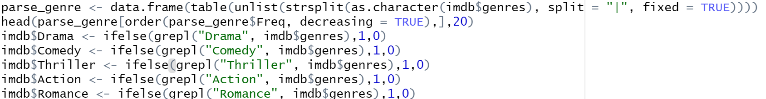
Pre-Processing Data
Parsing out the genres from the pipe-delimited string
Determine genres frequency
Create binary dummy variables for each genre

Slide 5
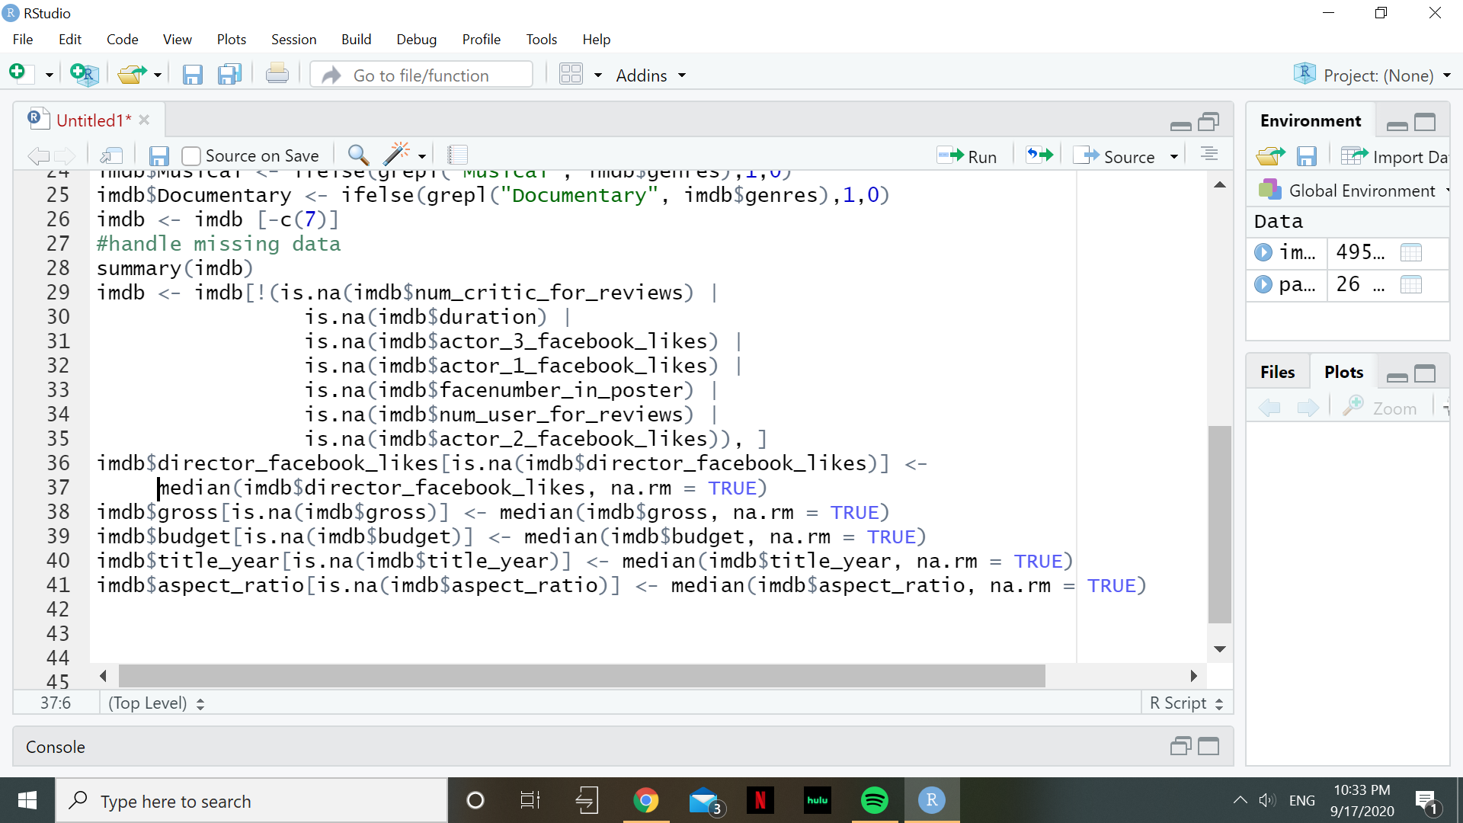
Pre-Processing Data
Handling missing data
For variables that miss less than 100 records, missing data is deleted.
For variables that miss more than 100 records, the median was imputed.

Slide 6
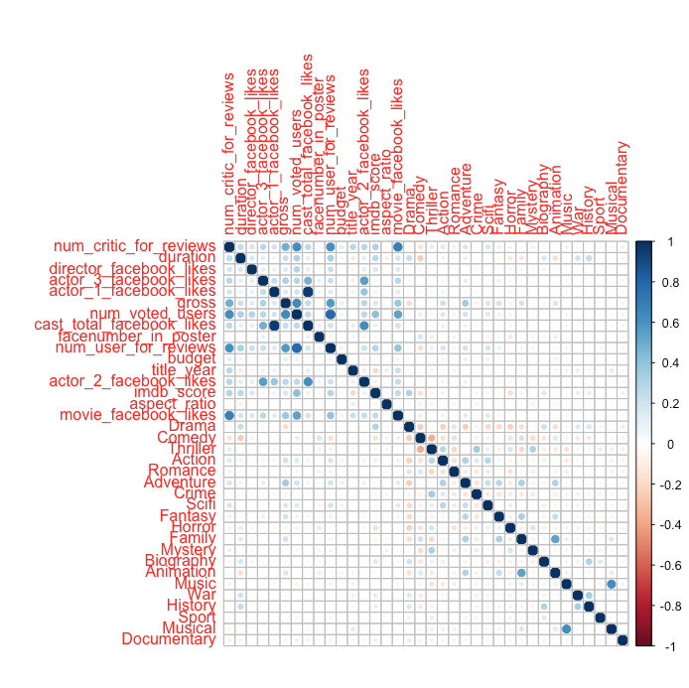
Pre-Processing Data
Removing highly correlated variables
Total cast Facebook likes and actor 1 Facebook likes are highly correlated
>.95
Total cast Facebook likes removed from variables
Notes:
library(tidyverse)
library(corrplot)
library(caret)
imdb.numeric <- imdb %>%
select_if(is.numeric)
imdb.cat <- imdb %>%
select_if(is.character)
m <- imdb.numeric %>%
cor()
corrplot(m)
max.cor <- .95
highlyCorDescr <- findCorrelation(m, cutoff = max.cor)
imdb.numeric <- imdb.numeric[,-highlyCorDescr]
# descrCor2 <- cor(imdb.numeric)
imdb <- cbind(imdb.numeric,imdb.cat)

Slide 7
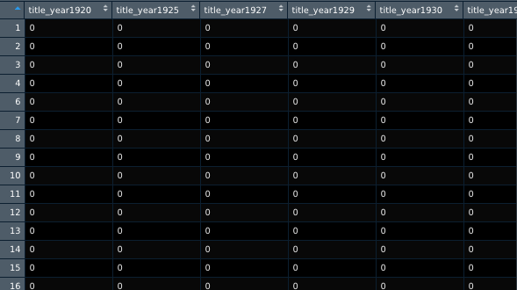
Pre-Processing Data
Transforming Number to Categorical data
The column title_year was transformed to a dummy_variables as the year should be treated as a categorical variable, not a numeric
This added an addition 90 variables to the model for what year the movie was released
Notes:
library(tidyverse)
imdb$title_year <- as.factor(imdb$title_year )
titleYears <- model.matrix(~ 0 + title_year,data = imdb) %>%
data.frame() %>%
select(-1)
imdb <- imdb %>%
select(-title_year) %>%
cbind(titleYears)

Slide 8
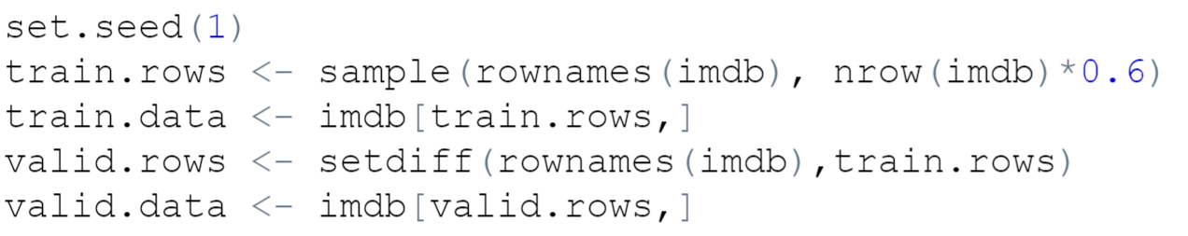
Partitioning Data
After preprocessing the data, it has been partitioned so that 60% of the data is training and 40% is validation.
Notes:
set.seed(1)
train.rows <- sample(rownames(imdb), nrow(imdb)*0.6)
train.data <- imdb[train.rows,]
valid.rows <- setdiff(rownames(imdb),train.rows)
valid.data <- imdb[valid.rows,]
head(train.data)

Slide 9
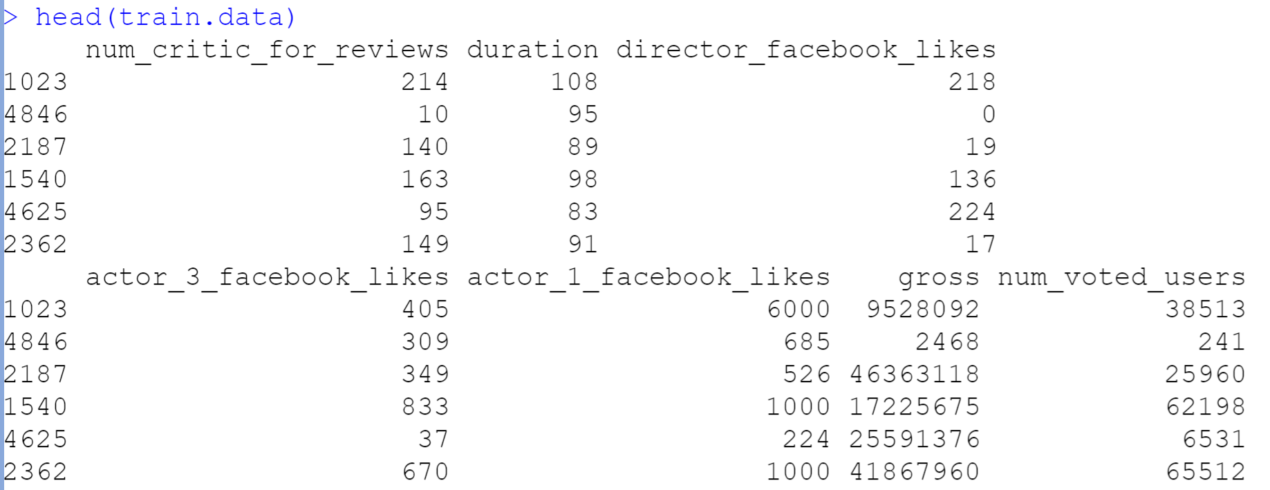
Partitioning Data
Sample of the partitioned data, more specifically the trained data

Slide 10
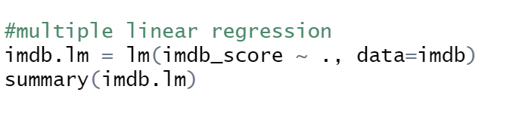
Multiple Linear Regression
Notes:
imdb.lm = lm(imdb_score ~ ., data=imdb)
summary(imdb.lm)

Slide 11
Multiple Linear Regression
When running the linear regression model on the IMDB dataset, we found that the variables that were significant were:
num_critic_for_reviews
duration
actor_1_facebook_likes
gross
num_voted_users
cast_total_facebook_likes
num_user_for_reviews
content_ratingApproved
content_ratingG
content_ratingNC-17
content_ratingNot Rated
content_ratingPassed
content_ratingPG
content_ratingPG-13
content_ratingR
content_ratingTV-14
content_ratingTV-G
content_ratingTV-MA
content_ratingTV-PG
Actor_2_facebook_likes
Aspect_ratio
Movie_facebook_likes
Drama
Comedy
Thriller
Action
Scifi
Horror
Biography
Animation
Sport
Documentary
title_year1920 - title_year 2016
Notes:
imdb.lm = lm(imdb_score ~ ., data=imdb)
summary(imdb.lm)

Slide 12
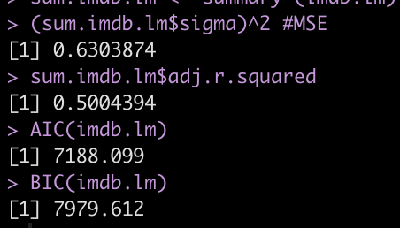
Multiple Linear Regression: Model Assessment
As for the R-Squared value and the significance of the model, the R Square is at roughly 50.04%. This means that the model is explaining about 50.04% of the data on the chart. This tells us that the model may not be the best fit for the data. This model, however, is very significant because the p-value is 2.2e-16, which is a lot less than the .05 needed to make the model significant.
Notes:
sum.imdb.lm <- summary (imdb.lm)
(sum.imdb.lm$sigma)^2 #MSE
sum.imdb.lm$adj.r.squared
AIC(imdb.lm)
BIC(imdb.lm)

Slide 13
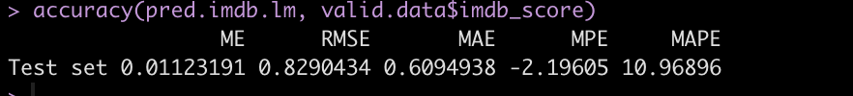
Multiple Linear Regression: Accuracy Metrics
Assess predictive performance of the full model using validation data set. The RMSE is relatively which shows the simplicity and accuracy of the model.
Notes:
library(forecast)
pred.imdb.lm <- predict(imdb.lm, newdata = valid.data)
accuracy(pred.imdb.lm, valid.data$imdb_score)

Slide 14
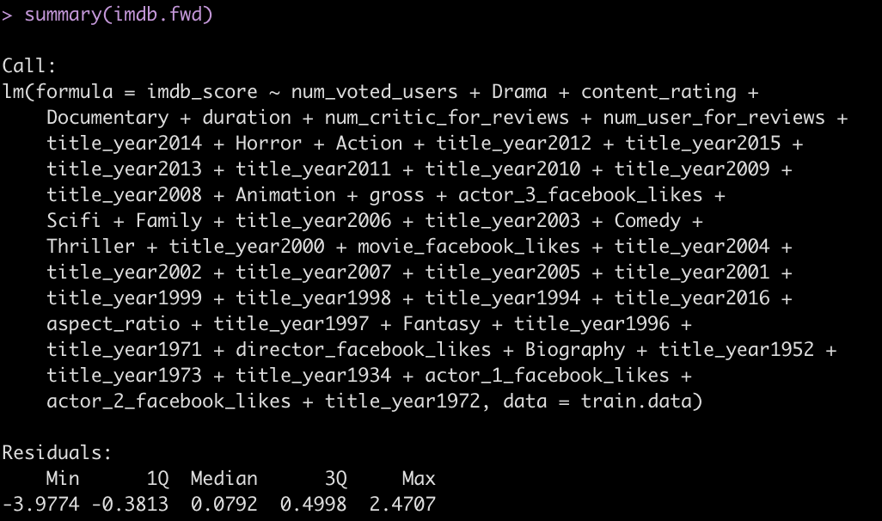
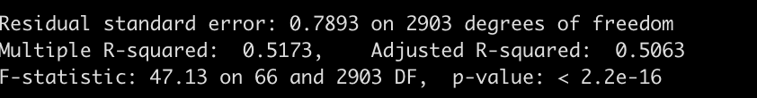
Variable Selection: Forward Selection
Forward selection found several significant variables to add to the model as seen below. The adjusted R-squared of this model is relatively low which means that it is not a great predictor of IMDB score. However, the p-value is also low which shows that there may be some significance.
Notes:
#variable Selection
imdb.null <- lm(imdb_score ~ 1, data = train.data)
imdb.full <- lm(imdb_score ~ ., data = train.data)
#forward Selection
imdb.fwd <- step(imdb.null, scope = list(lower = imdb.null, upper = imdb.full),
direction = "forward")
summary(imdb.fwd)

Slide 15
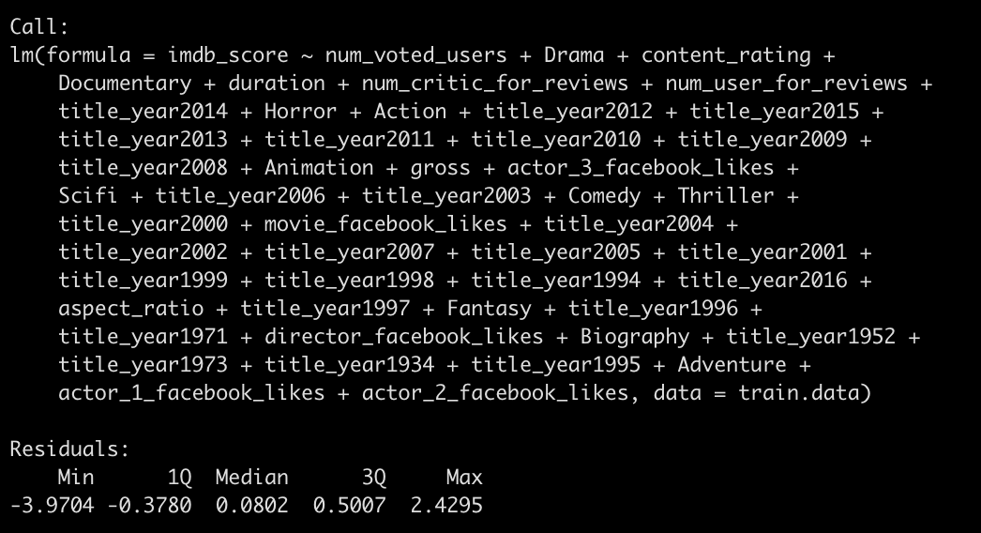
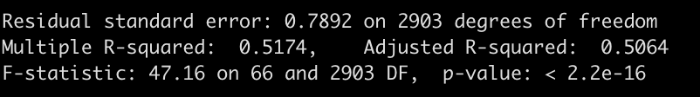
Variable Selection: Stepwise Selection
Stepwise selection also found several significant variables to add to the model as seen below. The adjusted R-squared of this model is also relatively low. However, it is slightly higher than the adjusted R-squared of the forward selection model, so this may be a slightly better predictor of IMDB score.
Notes:
#stepwise Selection
imdb.step <- step(imdb.null, scope = list(lower = imdb.null, upper = imdb.full),
direction = "both")
summary(imdb.step)

Slide 16
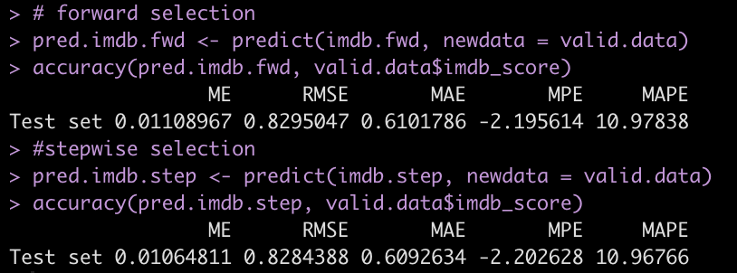
Variable Selection: Accuracy Metrics
Looking at the accuracy metrics for these two models, the forward selection has a higher RMSE. This means that it is a more simple and accurate predictor of IMDB Score than the Stepwise function.
Notes:
valid.data <- valid.data[valid.data$content_rating != "TV-Y", ]
# forward selection
pred.imdb.fwd <- predict(imdb.fwd, newdata = valid.data)
accuracy(pred.imdb.fwd, valid.data$imdb_score)
#stepwise selection
pred.imdb.step <- predict(imdb.step, newdata = valid.data)
accuracy(pred.imdb.step, valid.data$imdb_score)

Slide 17
Full and Reduced Model Performances
Model Name | Description | # of Predictors | Adj. R² | AIC | ME | RMSE
imdb.lm | Full multiple regression | 140 | 0.5004 | 7188.099 | 0.0116 | 0.829
imdb.fwd | Forward selection | 66 | 0.5063 | 7091.347 | 0.0110 | 0.829
imdb.step | Stepwise selection | 66 | 0.5064 | 7090.484 | 0.0106 | 0.828

Slide 18
Best Predictive Model
The best predictive model to use would be the Stepwise Selection Model. It has the largest R^2 and the smallest AIC.

Slide 19
Summary
Preprocessing the data:
Dropped irrelevant variables (see slide 3)
Parsed out genres and created dummy variables for each (see slide 4)
Handled missing data (see slide 5) and removed highly correlated variables (see slide 6)
Transformed years to categorical data (slide 7)
Partitioned the data into 60% training 40% validation (slide 8)
Ran regression:
Multiple Linear regression (see slides 12-13)
Forward Selection (see slide 14 and 16)
Stepwise Selection (see slide 15-16)
Checked accuracy of each regression and compared them to each other (see slide 17)
In conclusion, all of our models were very similar in accuracy; however, the stepwise function slightly out performed the other two. Overall, the linear models we created has relatively low R^2 values and may not be a great predictor of IMDB Scores.

